Slide 1
MODULE 5
Collaborative Working
www.balance.eu

Slide 2
CONTENTS
01
Introduction
02
Benefits of Collaboration
03
Embracing Collaboration
04
Team Collaboration
05
Tools & Tactics
06
Assessment Quiz

Slide 3

01
Introduction

Slide 4
LEARNING OUTCOMES
Welcome to the Collaborative Working Module for Work-Life Balance. This module gives you the insights and tools you need to successfully balance work and personal life. It will equip you with resources to allow team members to build a balanced and productive working environment that helps foster success for everyone.
1. Understanding the benefits of collaboration in promoting work-life balance.
2. Develop effective communication strategies for supporting your team and promoting work-life balance.
3. Understand the role of team building in promoting collaborative working and work-life balance.
4. Develop policies and practices that promote collaborative working and support work-life balance.
5. Identify digital tools and tactics that can support collaborative working and work-life balance.
Notes:
Make this a question for the

Slide 5

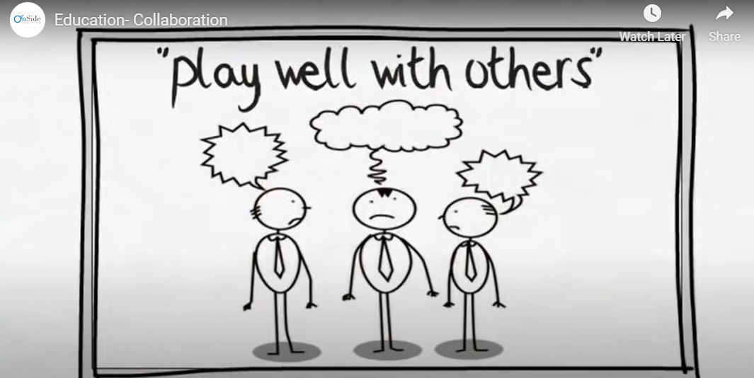
WHAT IS COLLABORATION & WHY IS IT IMPORTANT?
Collaboration is the process of two or more people or organisations working together to realise mutual advantage. It is a powerful business tool, regardless of the size of your business or the industry you are in. In practice, it is about working together to address problems and achieve goals that seem to be out of reach when working alone.
Collaborating with others can provide you with the additional skills and resources to do things you couldn’t achieve independently. This could be anything from developing a new product, using new material in your design process, securing a new client, or gaining access to funding.​
Education- Collaboration - Bing video

Slide 6
“Alone we can do so little. Together we can do so much.”
Helen Keller

Slide 7

02
Benefits of Collaboration

Slide 8

BENEFITS OF COLLABORATION
We know the saying - a problem shared is a problem halved.
​
Research shows that discussing problems with people in similar situations reduces stress levels. Problems don’t seem as overwhelming when you talk about them, and two people are more likely to find a solution than one.​
“Two heads are better than one”

Slide 9
BENEFITS OF COLLABORATION
When you bounce ideas off someone or lean on someone for their ideas and critiques, you magnify your own abilities in several ways and achieve a better work-life balance.
Momentum: Someone else is supporting you to move to the next step​. You can more easily delegate responsibilities.
Sources: You add more ideas to the project, more research, and another lifetime of knowledge​ and resources with team support.
Perspective: You see angles and flaws you would not have seen yourself.
Speed: You are able to work faster, and identify ideas more quickly​ for better productivity and time management.
Decisions: A sounding board helps you talk through your own decisions, and understand your own thinking more easily. ​
Validation: A good collaboration partner not only sees the flaws in your work but can help support your best ideas and spur you forward in the right direction and improve your job satisfaction.
Notes:
Make this a question for the

Slide 10
WAYS COLLABORATION WILL HELP YOU
The connections you form, and the different ways you collaborate will help you grow.
1. Collaboration Will Inspire You
It is easy to get into a routine during day-to-day operations and forget that there may be a better way to do something, different techniques to try, and new tools that can save you time and money. Collaborating with others gives you a fresh perspective, triggers your creativity, opens up objectively, and adds new context that goes beyond what you do and see each day. It helps you think in a new way.
Discover how you can cultivate collaboration here:
Cultivating Collaboration: Don't Be So Defensive! | Jim Tamm | TEDxSantaCruz - YouTube
Notes:
To achieve work life balance

Slide 11




WAYS COLLABORATION WILL HELP YOU
2. Collaboration Helps You Grow Your Network
People have a common interest in meeting new people and building a list of contacts and colleagues. This can be challenging. Being successful requires that you consistently make connections and form alliances.
Networking tips for introverts: Link
Simple ways to improve your
Networking skills: Link

Slide 12

WAYS COLLABORATION WILL HELP YOU
3. Collaboration Is Educational
One of the biggest benefits of collaboration is the opportunity for learning. In fact, every interaction you have with someone outside of your immediate circle can teach you something valuable.
Some of the most successful collaborations involve two professionals who bring two very different skill sets, perspectives, and strengths to the table.
When this happens, you are certain to be surrounded by learning opportunities.
Learn how to build a collaborative learning culture:
How To Build Collaborative Learning Cultures | Video Seminar Overview - YouTube

Slide 13
WAYS COLLABORATION WILL HELP YOU
4. Collaboration Solves Problems
There is a reason crowdsourcing is so popular; there is an undeniable power in numbers. If one person can't accomplish something on their own, two, three, or more people may be able to get it done.
The harder the problem is to solve, the more we can benefit from getting the input of someone outside of the situation. When you add new viewpoints and experiences to the mix, the result will often transcend what you originally set out to accomplish.
5 Expert Collaborative Problem-Solving Strategies | Redbooth
Let’s look at Collaborative Problem-Solving Strategies

Slide 14

03
Embracing Collaboration

Slide 15
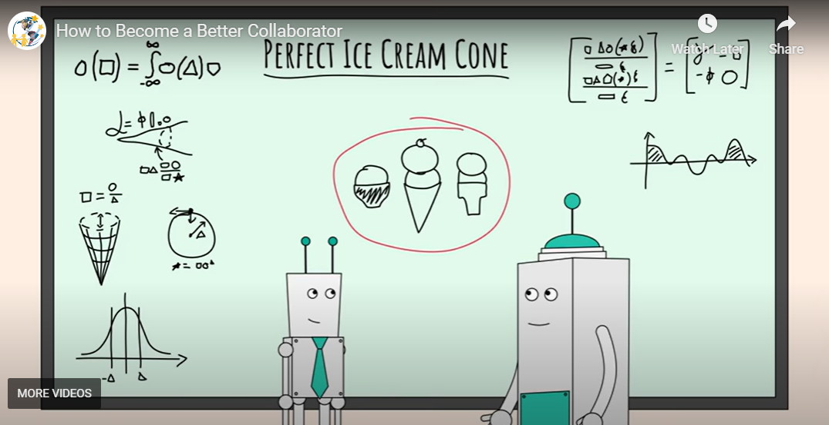
Effective Communication
To foster a positive work environment and help support your team, it’s essential to establish effective communication strategies. This includes engaging in active listening, providing clear and concise messaging, and having regular check-ins with your team members.
“The most important thing in communication is to hear what isn’t being said”
Peter F. Drucker
Watch here: How to become a better collaborator

Slide 16
HOW TO BE A GREAT COLLABORATOR
Let’s start with you:
You recognise that working well together and sharing knowledge will help achieve much more than you could create on your own.​
​You approach collaboration with a creative problem solver outlook​.
You value diverse viewpoints, and the expertise of others, and communicate well to get the job done.​
​You take pride in your own work and are keen to develop.
What skills do you need? Watch here:
6 Skills of Collaboration - Bing video

Slide 17

8 CHARACTERISTICS OF A GREAT COLLABORATOR
1. Team-focused - To successfully collaborate, you need to be a team player and think about "we" rather than "I". A great collaborator is mindful of shared goals and group success.​
12 Reasons Why Teamwork Is Important in the Workplace | Indeed.com
​2. Generous - A great collaborator is willing to take the first step and pitch in, even if they won't get the spotlight. Generosity is also an incredibly desirable leadership characteristic.​
3. Curious - Great collaborators are good at asking the right questions. They don’t interrogate; they simply follow their natural curiosity because they want to understand.​

Slide 18
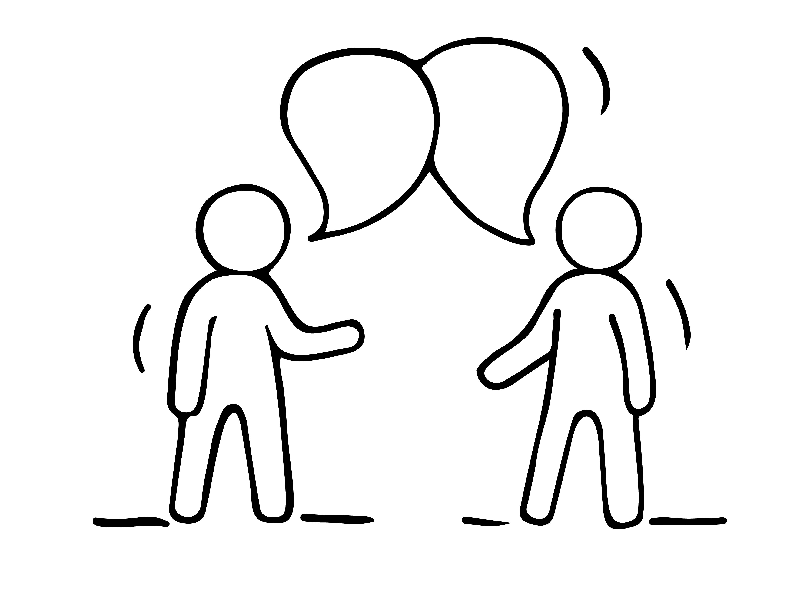
8 CHARACTERISTICS OF A GREAT COLLABORATOR
Appreciative - The best collaborators sincerely appreciate all the team members have contributed. They’re not shy about expressing this appreciation and they give credit where credit is due.
Emotional Intelligence - How to Lead with Emotional Intelligence - Bing video
5. Listens to understand - Great collaborators listen attentively to what is being said. More importantly, they listen to understand. ​
Active Listening: Techniques, Benefits, Examples (verywellmind.com)

Slide 19
8 CHARACTERISTICS OF A GREAT COLLABORATOR
6. Gives and expects trust - More than anything, highly successful collaborations are built on safety and trust. Great collaborators help create and maintain that trusting environment. They give their trust freely and expect to receive trust in return.
  15 Top Character Traits With Definitions and Examples | Indeed.com
7. Builds relationships; breaks down walls - Collaboration is all about working together. Great collaborators see the value in being usually well-connected and work hard to build and maintain relationships with others.​
  What’s the Best Way to Build Trust at Work? (hbr.org)
8. Diplomatic - The best collaborators are diplomats. They know that relationships are built on mutual respect.
  Diplomatic Skills: Definition and Examples | Indeed.com

Slide 20

04
Team Collaboration

Slide 21

Build a Strong Collaborative Team
Team building is an integral part of promoting a collaborative work environment and work-life balance. By engaging in team-building activities, employees are given an opportunity to work together to create a strong, cohesive team with clear boundaries, goals, expectations and a shared understanding of potential conflicts.
Set Clear Boundaries and Goals: When it comes to team building, it’s important to set clear boundaries and goals for the team. Goals should be Specific, Measurable, Achievable, Realistic and Time-Sensitive (SMART). This will ensure that the team is on the same page and working towards the same objective.
Define Expectations: Establishing clear expectations is essential for successful team building. Participating team members should understand the task, how their individual contributions contribute to the team’s overall objective, and the other team members’ roles.
Identify Potential Conflicts Early: It’s important to anticipate and identify any potential conflicts early on. This can be achieved by setting ground rules at the beginning of the team-building activity that will be enforced throughout.
Hold Your Team Accountable: Once the boundaries and expectations have been set, it’s important to hold your team accountable.

Slide 22
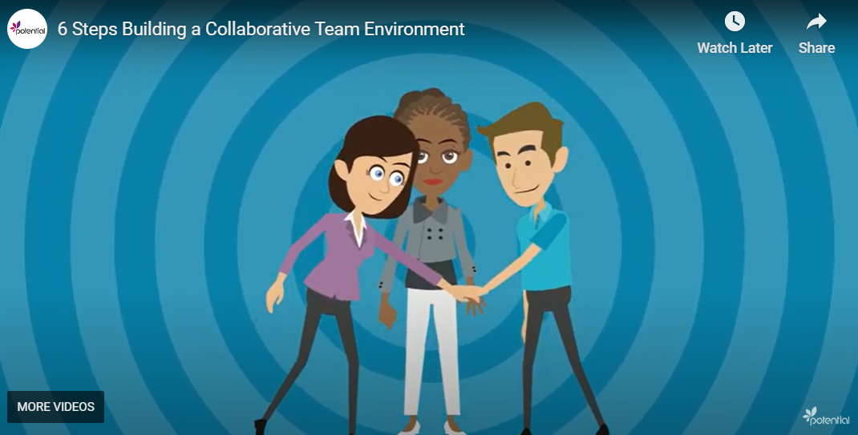
Build a Strong Collaborative Team
Learn more here:
6 Steps Building a Collaborative Team Environment - Bing video
3 Powerful Collaboration Activities and Team-Building Exercises for Work - Bing video

Slide 23
STEPS TO COLLABORATE SUCCESSFULLY AS A TEAM
Leaders play a crucial role in promoting collaboration and work-life balance. Encouraging open communication, providing resources, and recognising employees' contributions can create a positive work environment.
Select collaborators ​- Enlist collaborators with little overlap with your fields of expertise, this will ensure each collaborator has a unique contribution to make.
Clarify roles ​& relationships​ - Confusion or doubt about who has what role is the usual source of tension and conflict in a collaborative project. This frequently leads to miscommunication and flawed outcomes.
Set up clear communication paths ​- Communication is central to collaboration because creative dialogue sparks ideas that the participants would never have had on their own.​
Foster open communication​ - The trust built up in a good collaborative circle gives everyone the confidence to advance an incomplete or inadequate thought, knowing that it may catalyse other ideas in the conversation.​
Record your ideas - Document profusely: keep your post-its, flip charts, diagrams, and notes. But bear in mind that every so often it's helpful and healthy to erase the whiteboard and fill it back up from memory.

Slide 24

05
Tools & Tactics

Slide 25
CREATING A COLLABORATIVE WORKPLACE
It's important to note that different organisations may have different policies and practices depending on their industry, culture, and specific needs. Implementing a combination of these strategies can create a collaborative and supportive work environment while promoting work-life balance.
Flexible work arrangements: Offering flexible work options such as flexible hours, compressed workweeks, remote work, or hybrid work can enable employees to better manage their work-life balance. This flexibility allows them to adjust their schedules to accommodate personal obligations while still meeting work requirements.
Training and development: Providing training and development opportunities that focus on collaboration and interpersonal skills can enhance employees' ability to work together effectively.
Technology tools for collaboration: Implementing collaboration tools and technologies, such as project management platforms, instant messaging, and video conferencing tools, can facilitate communication and collaboration among employees, especially in remote or distributed teams.
Workload management and realistic expectations: Ensuring that workloads are manageable and reasonable help prevent burnout and supports work-life balance.
Support programs and policies: Offering employee assistance programs, wellness initiatives, and policies that promote work-life balance, such as parental leave, flexible holiday policies, and sabbatical programs, shows an organisation's commitment to supporting its employees.

Slide 26

TIPS FOR YOUR SUCCESSFUL COLLABORATIONS​
Stay open to ideas you didn't expect. ​
Plan for emergent ideas and be willing to change direction.​
Honesty is key for any collaboration; make sure each person knows and is clear about what they expect from the partnership from the outset. There needs to be clarity on why the collaboration is taking place and what each partner hopes to achieve. Answer these questions, WHO, WHAT, WHY, WHEN, WHERE, HOW?
Collaborations will repay handsomely, as long as you are just as interested in the process as much as the outcome itself.
Finally, don’t be a hero! In the words of Lorna Davis, it can be ineffective and dangerous. We need each other:A guide to collaborative leadership | Lorna Davis - Bing video
​

Slide 27
COLLABORATION TOOLS AT A GLANCE
5 COLLABORATION TOOLS AT A GLANCE
TEDx Events - great for networking and meeting possible collaborators​.
Social Media e.g. Facebook Groups or LinkedIn- use open groups to create an instant creative ​community or why not have a private group for your creative collective​
Entrepreneurship forums – a great way for making international connections​
Meet up (website/app) – a great way of making connections and finding creative networking events/groups near you.
Free online social collaboration platforms - e.g. Teams, Slack, Zoom. The Communication Kit for Working Remotely - Dropbox
Find lots more tools for work and time management in our Better Balance Guide: LINK

Slide 28

05
Quiz

Slide 29
SELF- ASSESSMENT 1/4
Can you name 3 benefits of collaboration?
1. Speed, Sources and Perspective.
2. Autonomy, Ideas and Speed.
3. Validation, Challenging Beliefs and Role modelling.

Slide 30
SELF- ASSESSMENT 2/4
What are two ways to collaborate successfully?
1. Select collaborators but work solely.
2. Set up clear communication paths and grow your network.
3. Create a plan, record ideas and implement them one by one.

Slide 31
SELF- ASSESSMENT 3/4
HOW TO BE A GREAT COLLABORATOR?
1. You recognise that working well together and sharing knowledge will help achieve much more than you could create on your own.​
2. Collaborate with other people but don’t share your ideas.
3. Use collaboration only for getting work done faster by others.

Slide 32
SELF- ASSESSMENT 4/4
HOW DO YOU RECOGNISE A COLLABORATIVE WORKPLACE?
1. Additional training is offered to some employees.
2. It rewards people for working hard and reaching targets.
3. The organisation sets clear expectations about flexible working arrangements.

Slide 33

OVERVIEW
We hope you found this Collaborative Working Module useful to equip you and your organisation with the necessary collaborative skills, communication strategies, and tools to enhance collaboration and see its benefits to supporting work-life balance.
Good luck in your quest to achieve a better work-life balance.

Slide 34
Recap of modules:
Module 1: Managing a remote team and work-life balance
Module 2: Organisational and individual responsibilities
Module 3: Digital Wellbeing
Module 4: Catering for a diverse team
Module 5: Collaborative working environment
www.balance.eu

