Slide 1
MODULE 4
Catering for a Diverse Team
www.balance.eu

Slide 2
CONTENTS
01
Learning Objectives
02
Introduction
03
Diversity & Inclusion in the Work Environment
04
Self-Assessment Quizzes
05
Conclusion

Slide 3
LEARNING OBJECTIVES
01
Understand the importance of diversity and inclusion in promoting work-life balance, and how to recognize and address the unique needs of diverse team members.
02
Identify common barriers to work-life balance for employees from diverse backgrounds, such as those with caregiving responsibilities, disabilities, or language barriers, and develop strategies to address these barriers.
03
Understand the role of organizational policies and practices in promoting diversity and inclusion and supporting work-life balance, such as flexible work arrangements, benefits and leave policies and accommodations for disabilities.
04
Develop effective communication strategies for promoting diversity and inclusion and addressing the needs of diverse team members, including active listening, cultural competence, and empathy.
05
Develop a plan for promoting diversity and inclusion in your workplace and ensuring that all team members' needs are being met, including strategies for creating an inclusive work environment, addressing barriers to work-life balance, and promoting cultural competence and understanding.

Slide 4

01
Introduction to Module 4

Slide 5
INTRODUCTION TO MODULE 4
Welcome to Module 4 of the BALANCE Online Course:
Catering for a Diverse Team!
In this module, we will explore the importance of diversity and inclusion in promoting work-life balance!
By the end of this module, you will be equipped with the knowledge and tools to create a more inclusive work environment and support work-life balance for all team members.

Slide 6

02
Diversity & Inclusion

Slide 7

What is inclusion for you?

Slide 8
Diversity & Inclusion
Diversity and inclusion are essential in promoting work-life balance in the workplace.
Diversity refers to the presence of a variety of backgrounds, experiences, and perspectives within a team or organisation.
Inclusion is the practice of creating an environment where all individuals feel valued, respected, and included, regardless of their differences.
The benefits of diversity and inclusion in the workplace extend beyond social responsibility; they can also lead to improved wellness, productivity, and staff satisfaction.
When individuals feel included and supported, they are more likely to achieve a healthy work-life balance.

Slide 9
Dimensions of diversity
Religion & Beliefs
Gender
Ethnicity, Nationality & Race
Age
Socioeconomic background
Sexual Orientation
Abilities & Disabilities

Slide 10
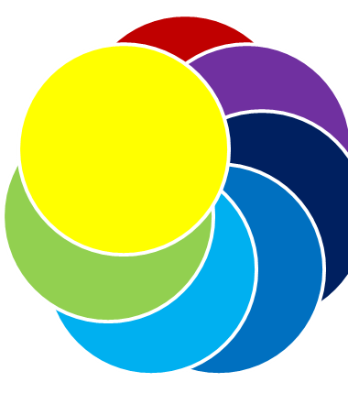
Don’t Forget:
Each person is unique, and these dimensions are only examples of someone’s identity.
INTERSECTIONALITY
Each person can hold multiple dimensions of diversity. These dimensions are interlocking and interacting. They lead to unique experiences and of course unique people! ☺

Slide 11
Recognising and Addressing Unique Needs
Person-centred perspective: every person and their needs are unique: to promote work-life balance effectively, it is crucial to recognise and address the unique needs of diverse team members.
Understanding and acknowledging the different challenges and requirements that individuals may have based on their gender, religion, ethnicity, nationality, race, socioeconomic background, disabilities, sexual orientation, and helps create a supportive and inclusive environment.
Developing awareness and empathy towards diverse needs enables workplace leaders to provide appropriate support.
Strategies for addressing unique needs include actively listening to team members, open communication, and tailored solutions based on individual circumstances.

Slide 12
Can YOU think of specific barriers based on the previous dimensions?

Slide 13

Diverse team members may face various barriers to achieving work-life balance. Examples:
• Gender: Women or non-binary people may face challenges related to societal expectations around caregiving responsibilities and work-life integration.
• Religion & Beliefs: Employees with religious obligations may require accommodations for prayer times or religious holidays.
• Ethnicity, Nationality & Race: Individuals from minority racial or ethnic groups may encounter systemic barriers and biases that affect their work-life balance.

Slide 14

Diverse team members may face various barriers to achieving work-life balance. Examples:
• Socioeconomic Background: Employees from lower socioeconomic backgrounds may face financial stressors and limited access to resources that impact their work-life balance.
• Disabilities: People with disabilities may require accommodations to perform their roles effectively and maintain work-life balance.
• Sexual Orientation: LGBTQ+ individuals may encounter unique challenges related to workplace acceptance and support.
• Age: Different age groups may have distinct work-life balance needs, such as flexible scheduling for caregivers or phased retirement options.
Identifying and addressing these barriers is essential for promoting an inclusive and supportive work environment.

Slide 15
Addressing Barriers to Work-Life Balance
• Develop policies and practices that address specific barriers faced by diverse team members in achieving work-life balance.
• Provide flexible work arrangements, such as remote work options, flexible schedules, or job-sharing opportunities.
• Offer support programs, training, resources, and assistance.
• Ensure inclusion, equality and respect.

Slide 16

Creating an Inclusive Work Environment
Fostering an inclusive work environment is vital for promoting diversity, inclusion, and work-life balance. Celebrate diversity and recognise individual contributions to create a sense of belonging and inclusivity.
Implement strategies that promote respect, fairness, and equal opportunities for all team members.
Encourage collaboration and teamwork among diverse team members to leverage their unique perspectives and skills.
Offer diversity and inclusion training programs to enhance awareness and understanding among employees, promoting an inclusive work environment.
Ensure leadership commitment to diversity and inclusion by setting an example, championing initiatives, and holding leaders accountable for fostering an inclusive culture.

Slide 17
Promoting Cultural Competence and Understanding
Cultural competence is vital for fostering diversity, inclusion, and work-life balance.
Provide cultural competency training for all team members to enhance their understanding of different cultures, beliefs, and practices.
Encourage open dialogue and create opportunities for learning and sharing cultural experiences. Celebrate diverse cultural traditions!
Foster inclusivity and respect for diverse perspectives, ensuring everyone feels valued and appreciated.
Implement mentoring programs that pair individuals from different backgrounds, genders, ages, religions, etc., fostering cross-cultural learning, empathy and understanding.

Slide 18
Strategies & Policies to Address Barriers
To address the barriers faced by diverse team members, workplace leaders can implement various strategies:
• Gender: Offer family-friendly policies, such as flexible work arrangements, remote or part-time options and parental leave, to support work-life balance for all caregivers.
• Religion & Beliefs: Provide reasonable accommodations for religious observances, such as flexible scheduling or designated prayer spaces.
• Ethnicity, Nationality & Race: Foster a culture of inclusivity and equality, promoting diversity in leadership and combating bias and discrimination. Promoting language diversity and inclusivity by offering language training programs or translation services.

Slide 19
Strategies & Policies to Address Barriers
• Socioeconomic Background: Implement programs that address financial well-being, such as employee assistance programs or financial education resources.
• Disabilities: Ensure workplace accessibility, provide reasonable accommodations, such as ergonomic workstations, assistive technologies, or modified work tasks and foster a culture of inclusivity and understanding.
• Sexual Orientation: Create LGBTQ+-inclusive policies and benefits, promote allyship, and foster a safe and accepting work environment. Use inclusive language.
• Age: Offer age-inclusive practices, such as phased retirement options or mentoring programs for intergenerational knowledge sharing.
These strategies help create an environment that recognizes and supports the diverse needs of team members, facilitating work-life balance.

Slide 20

Developing a Plan for Promoting Diversity and Inclusion
• Developing a comprehensive plan is essential for promoting diversity and inclusion and ensuring that all team members' needs are met.
• Start by assessing the current state of diversity and inclusion in your workplace, considering representation, inclusivity, and the overall work environment.
• Identify areas for improvement and set specific goals that align with promoting diversity, inclusion, and work-life balance.
• Involve key stakeholders, such as team members, HR representatives, and executives, to obtain buy-in and support.
• Regularly monitor progress and evaluate the effectiveness of the implemented initiatives.
• Make necessary adjustments based on feedback, data, and evolving needs

Slide 21
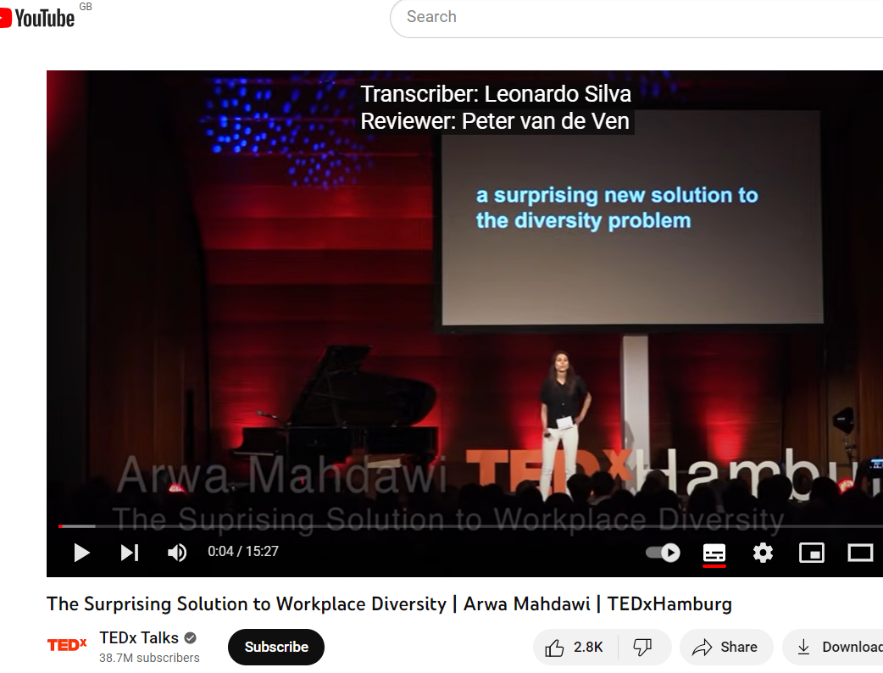
Activity: Watch!
The Surprising Solution to Workplace Diversity | Arwa Mahdawi | TEDxHamburg
Click HERE to watch!

Slide 22
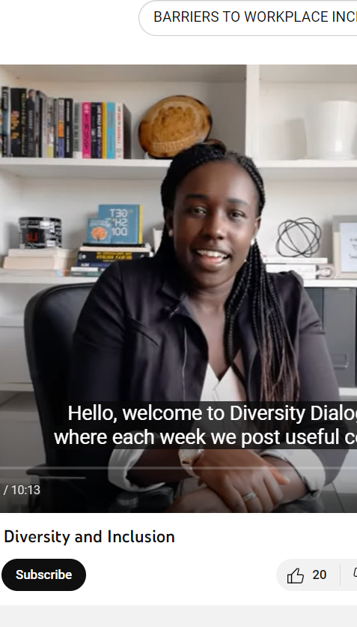
Activity: WATCH!
Barriers to Workplace Diversity and Inclusion:
This video explores some of the barriers that hinder effective workplace diversity and inclusion.
Click HERE to watch!

Slide 23
Examples of policies
Link to the Knowledge Base:
The Gender Equality and Equal Treatment Commissioner
https://volinik.ee/wp-content/uploads/2021/05/checklist.pdf
Estonian Human Rights Center, Aga Khan Foundation (Portugal) and Equality Strategies (Ireland)
https://humanrights.ee/app/uploads/2021/08/DI-in-times-of-crisis-guide.pdf
https://www.tooelu.ee/et/uudised/216/valminud-juhend-tooandjatele-
mitmekesisuse-juhtimisest-kriisiajal

Slide 24

03
Quiz

Slide 25
SELF- ASSESSMENT
Which of the following is true about the importance of diversity and inclusion in promoting work-life balance?
A) Diversity and inclusion have no impact on work-life balance.
B) Diversity and inclusion can improve wellness, productivity, and staff satisfaction.
C) Work-life balance is not affected by the unique needs of diverse team members.
D) Flexible work arrangements have no connection to diversity and inclusion.
2. What are some common barriers to work-life balance for employees from diverse backgrounds?
A) Caregiving responsibilities, disabilities, and language barriers
B) Lack of team collaboration and communication
C) Inflexible work arrangements and limited benefits
D) All of the above

Slide 26
SELF- ASSESSMENT
3. Which of the following is an example of an organizational policy promoting diversity and inclusion and supporting work-life balance?
A) Offering flexible work arrangements and leave policies
B) Providing accommodation for disabilities and language barriers
C) Implementing cultural competency training for team members
D) All of the above
4. What are effective communication strategies for promoting diversity and inclusion in a team?
A) Active listening, cultural competence, and empathy
B) Encouraging homogeneous perspectives and avoiding discussions on diversity
C) Ignoring individual needs and preferences
D) Using stereotypes to categorize team members

Slide 27
SELF- ASSESSMENT
5. True or False: Embracing diversity and inclusion in the workplace has no impact on work-life balance.
False
6. True or False: Socioeconomic background has no influence on an individual's work-life balance.
False

Slide 28
SELF- ASSESSMENT
7. What is one strategy for addressing barriers to work-life balance for employees regarding gender?
a) Offering parental leave and childcare support
b) Providing financial education resources
c) Establishing LGBTQ+-inclusive policies and benefits
d) All of the above
8. What does cultural competence entail?
a) Understanding and respecting different cultures, beliefs, and values
b) Implementing flexible work arrangements
c) Fostering collaboration and teamwork
d) Offering accommodations for disabilities

Slide 29
04
Conclusion

Slide 30

OVERVIEW
Creating an inclusive and safe work environment that celebrates diversity fosters collaboration and it is vital for the promotion of work-life balance. It is important to recognise and address the unique needs of diverse team members based on their gender, religion, ethnicity, nationality, race, socioeconomic background, disabilities, sexual orientation, and age, through communication strategies, equality policies, work arrangements, empathy and understanding.
DON’T FORGET!
Always include your employees in your decisions.
It is the only way to learn, understand and address their real needs. Ask them and don’t assume ☺

Slide 31

Go to Module 5:
Collaborative work environments
Follow Our Journey
www.balance.eu

