Slide 1
MODULE 1
Managing a remote team and work-life balance
www.balance.eu

Slide 2
TABLE OF CONTENTS
01
Unit 1: Introduction to Work-Life Balance
02
Unit 2: Organisational Role in Promoting Work-Life Balance
03
Unit 3: Strategies for Achieving Work-Life Balance
04
Unit 4: Organisational Responsibilities towards Work-Life Balance
05
Unit 5: Managing Remote Teams and Ensuring Effective Communication
06
Self Assessment

Slide 3
LEARNING OBJECTIVES
01
Define work-life balance, identify signs of imbalance, and understand its importance and implications for personal well-being and professional productivity.
02
Understand the organisational role, including the influence of corporate culture and leadership, in promoting work-life balance, and be able to identify beneficial practices that foster balance.
03
Implement effective strategies for achieving work-life balance, including setting personal boundaries, managing time, and practising stress management and self-care
04
Recognize the legal and ethical responsibilities of organisations in promoting work-life balance, including establishing supportive policies and promoting mental health.
05
Understand the unique dynamics, challenges, and communication strategies of managing remote teams, with a special focus on ensuring work-life balance in remote work settings.
06
Analyse and reflect on their own responsibilities, the impact of organisational culture, and practical applications of work-life balance strategies through engaging activities, case studies, and discussions.

Slide 4

01
Introduction to Work-Life Balance

Slide 5

Definition and Importance of Work-Life Balance
Work-life balance refers to the harmonious distribution of time, energy, and attention between professional activities and other essential aspects of life, including personal interests, family, and social interactions.
According to the European Agency for Safety and Health at Work (EU-OSHA), achieving a satisfactory work-life balance is vital to individuals' wellbeing and satisfaction, and it also significantly impacts productivity and morale in professional environments.
A balanced approach to work and personal life allows individuals to meet their professional obligations without jeopardising their health and personal lives, thereby enhancing personal satisfaction and professional effectiveness.

Slide 6

Signs of Poor Work-Life Balance
Recognising the signs of poor work-life balance is essential for preventative measures and interventions.
Some of these indicators may include persistent fatigue, decreased productivity, increased stress levels, inability to disconnect from work during leisure time, neglect of personal and family obligations, recurring health problems such as headaches or frequent illness, and general feelings of dissatisfaction and discontentment. Mental health can be significantly impacted, potentially leading to conditions such as anxiety and depression.
The European Framework for Psychosocial Risk Management (PRIMA-EF) emphasises the importance of awareness and early detection of these symptoms.

Slide 7

Consequences of a Lack of Work-Life Balance
An imbalance between work and personal life can yield significant repercussions for both individuals and organisations. On a personal level, individuals may experience burnout, a state of chronic physical and emotional exhaustion typically accompanied by feelings of cynicism and reduced accomplishment. Stress-related health conditions such as sleep disorders, cardiovascular diseases, and mental health issues may also develop.
From an organisational perspective, poor work-life balance among employees can result in heightened absenteeism, decreased productivity, increased turnover rates, and a decline in work quality. Moreover, it can adversely affect the organisation's reputation, thus posing challenges in attracting and retaining skilled employees. The European Pillar of Social Rights underscores the importance of addressing these issues to foster a healthy work environment.

Slide 8
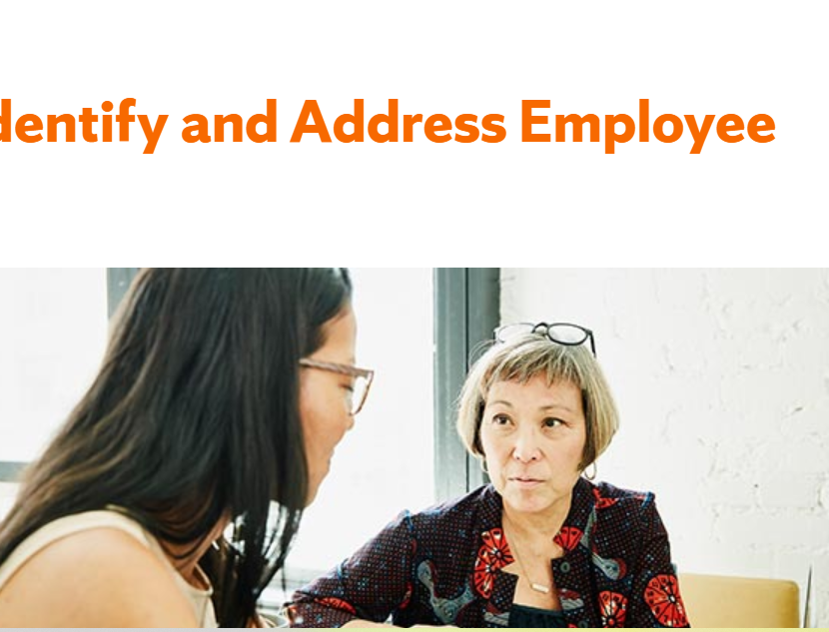
Signs of work life imbalance to watch out for
Job burnout: Click HERE to learn how to spot it and take action!

Slide 9
Personal and Professional Benefits of Good Work-Life Balance
Preserving a healthy work-life balance confers numerous advantages. Personally, it can contribute to improved health, provide more time for personal interests and relationships, alleviate stress levels, and boost overall life satisfaction. It enables individuals to nurture their physical, emotional, and mental wellbeing, thereby enhancing their quality of life.
Professionally, employees who maintain a favourable work-life balance tend to exhibit heightened job satisfaction, improved productivity, and reduced stress and burnout levels. They display greater engagement in their work, which can result in superior work quality. For organisations, fostering a sound work-life balance can enhance employee retention, diminish absenteeism, bolster the company's reputation, and ultimately foster a healthier, more productive work environment.
According to the EU Strategy on Health and Safety at Work 2021-2027, facilitating work-life balance is a fundamental aspect of improving occupational safety and health.

Slide 10
Activity - Reflecting on Work-Life Balance Challenges
1. To personalize our understanding of work-life balance, consider the women in your organization or your personal life.
What specific challenges do they encounter in maintaining a healthy work-life balance? Note down your observations and thoughts. We will use these reflections to spark a discussion and derive collective insights.
2. Instructions:
Allow participants a few minutes to jot down their thoughts.
Then encourage open sharing and discussion, prompting everyone to participate actively.
This activity serves as a bridge, connecting theoretical concepts with real-life scenarios and fostering a deeper understanding of the issue.

Slide 11
References for Unit 1
Chron: The Effects of Work & Life Imbalance
https://work.chron.com/effects-work-life-imbalance-5967.html
Indeed: Work-life imbalance: what it means and its effect
https://uk.indeed.com/career-advice/career-development/work-life-imbalance
The European Pillar of Social Rights Action Plan
https://op.europa.eu/webpub/empl/european-pillar-of-social-rights/en/
Promote healthy work-life balance in your business
https://www.nibusinessinfo.co.uk/content/advantages-improved-work-life-balance#:~:text=Work%2Dlife%20balance%20advantages%3A%20employees&text=increased%20productivity,or%20family%20life%20is%20important
7 Benefits of a Work Life Balance for Employers & Employees
https://fmpglobal.com/blog/business-benefits-good-work-life-balance/
EU strategic framework on health and safety at work 2021-2027
https://www.ilo.org/budapest/what-we-do/projects/declared-work-ukraine/WCMS_811860/lang--en/index.htm#:~:text=This%20new%20strategy%20focuses%20on,for%20possible%20future%20health%20threats

Slide 12

02
Organisational Role in Promoting Work-Life Balance

Slide 13

The Impact of Corporate Culture on Work-Life Balance
Corporate culture plays a critical role in shaping work-life balance within an organisation.
A culture that encourages long working hours and values employees based on their time spent in the office rather than their productivity can contribute to a poor work-life balance.
On the other hand, a culture that promotes flexibility, values employee wellbeing, and respects personal time can facilitate a healthy work-life balance.
The EU's New Strategic Framework on Health and Safety at Work 2021–2027 underscores the importance of healthy work environments and cultures that promote work-life balance.

Slide 14

The Organisational Benefits of Supporting Work-Life Balance
Supporting work-life balance within an organisation can yield significant benefits.
These include improved employee morale, increased productivity, reduced absenteeism, and lower staff turnover rates.
It can also enhance the organisation's reputation, making it a more attractive workplace for current and potential employees.
The European Pillar of Social Rights recognises the organisational benefits of supporting work-life balance and encourages businesses to develop family-friendly policies.

Slide 15
Role of Leadership in Fostering Work-Life Balance
Leadership plays a crucial role in promoting work-life balance. Leaders can set the tone by modelling healthy work-life balance behaviours and supporting policies that encourage work-life balance, such as flexible working hours, remote work opportunities, and family leave policies.
The European Framework for Psychosocial Risk Management (PRIMA-EF) emphasises the importance of supportive leadership in mitigating psychosocial risks and fostering a balanced work environment.
WELCOME TO BALANCE

Slide 16

Role of Childcare Support
Providing support for childcare is a powerful method of alleviating stress and improving work-life balance. This can involve providing direct access to childcare facilities, providing subsidies, or offering flexible schedules that accommodate childcare needs.
The revised Barcelona objectives set by the EU encourage member states to provide adequate childcare to improve work-life balance, emphasizing that such support is essential to ensure gender equality in the workforce.

Slide 17
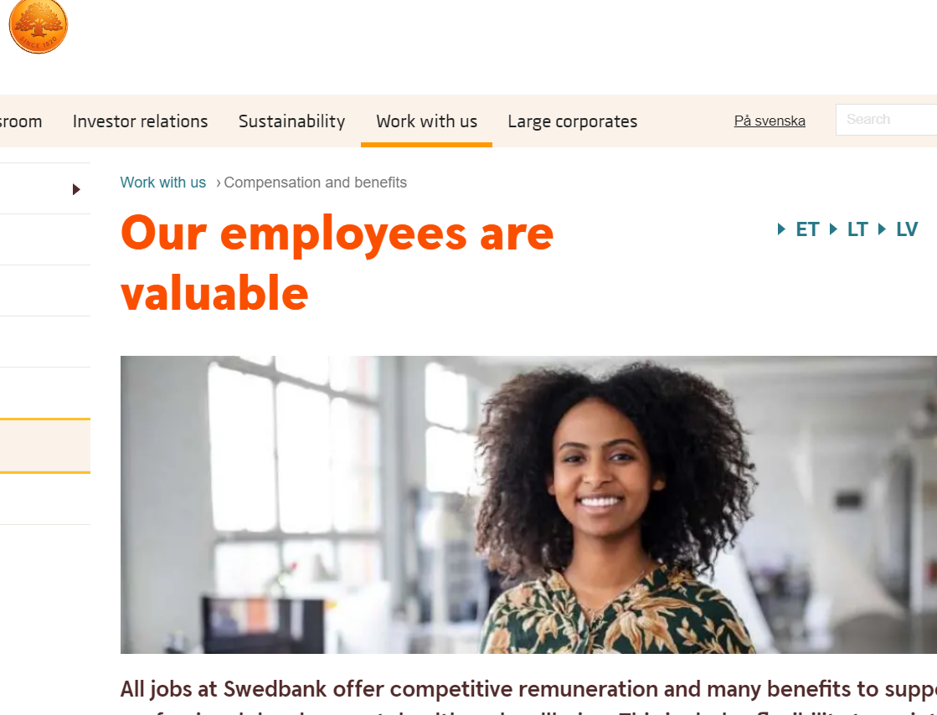
Activity - Discussion or Case Study on Effective Workplace Policies
Let's look at the case of Swedbank HERE, a Swedish company. They have implemented a variety of family-friendly policies, including flexible working hours and remote work options. These policies have been lauded for promoting a healthier work-life balance.
Reflect on the impacts of these policies. Discuss their potential effects, strengths, and weaknesses with your group. How could such policies be implemented or improved in your workplace? Reflect on these questions individually or discuss in groups.

Slide 18
ACTIVITY- Group Discussion: Identifying Practices that Encourage Work-Life Balance in an Organisation
Objective: To help participants identify organisational practices that promote work-life balance.
Instructions:
Divide participants into small groups.
Ask each group to discuss and list practices that an organisation can adopt to promote work-life balance.
Have each group present their findings to the rest of the class for further discussion. Consider comparing these findings to strategies recommended in the EU's New Strategic Framework on Health and Safety at Work.

Slide 19
References for Unit 2
Summer 2018, The Effect of Organizational Culture on Work-Life Balance, Elinor S. Groner, Gettysburg College
https://cupola.gettysburg.edu/cgi/viewcontent.cgi?article=1721&context=student_scholarship#:~:text=Organizations%20which%20have%20policies%20and,the%20overall%20balance%20will%20decrease.
Gender Equality in Academia and Research - GEAR tool
https://eige.europa.eu/gender-mainstreaming/toolkits/gear/work-life-balance-and-organisational-culture?language_content_entity=en
How to Create a Culture that Supports Work-Life Balance
https://succeedsmart.com/blog/how-to-create-a-culture-that-supports-work-life-balance
EU strategic framework on health and safety at work 2021-2027
https://www.ilo.org/budapest/what-we-do/projects/declared-work-ukraine/WCMS_811860/lang--en/index.htm#:~:text=This%20new%20strategy%20focuses%20on,for%20possible%20future%20health%20threats
The European Pillar of Social Rights and the ‘New Start’ initiative on Work/Life balance: why are they relevant for Eurocarers?
https://eurocarers.org/wp-content/uploads/2022/02/TheEuropeanPillarofSocialRights-Update-14-June-2017.pdf
The Role of Leadership in Creating and Maintaining a Positive Work-life Balance
https://www.tutorialspoint.com/the-role-of-leadership-in-creating-and-maintaining-a-positive-work-life-balance
European Framework for Psychosocial Risk Management (PRIMA-EF)
https://apps.who.int/iris/bitstream/handle/10665/43966/9789241597104_eng_Part1.pdf;jsessionid=09B83CC5F04B42FD38AFE3B6FB26C5F3?sequence=1
Knowing your rights for work-life balance
https://workingfamilies.org.uk/news-events/blogs/knowing-your-rights-for-work-life-balance/

Slide 20

Strategies for Achieving Work-Life Balance
03

Slide 21

Setting Boundaries between Work and Personal Life?
Creating a distinct separation between work and personal life is crucial for maintaining a healthy work-life balance.
This might include designating specific work hours, creating a separate workspace at home, and limiting work-related communications during non-work hours.
For women, who often juggle multiple roles including caregiving responsibilities, setting boundaries can be particularly important.
The European Pillar of Social Rights acknowledges the unique challenges faced by women in achieving work-life balance and promotes policies that support the establishment of such boundaries. The 'right to disconnect' or 'right to be unavailable' has gained traction in several EU countries, recognizing the importance of separating work and personal time.

Slide 22
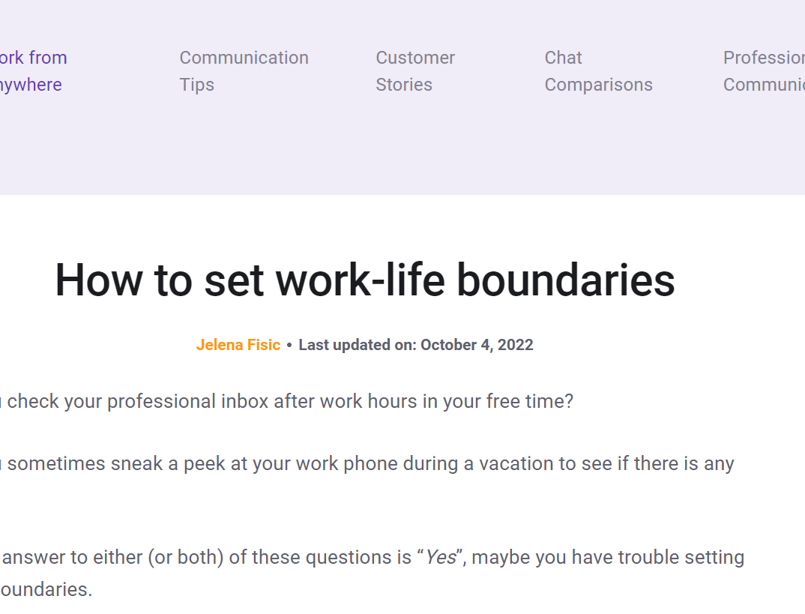
Activity: How to set work-life boundaries
8 Tips on creating healthy work boundaries
Click link HERE to follow their steps on creating a better work place balance!

Slide 23

Time Management Techniques
Effective time management is a critical strategy for achieving work-life balance. Techniques may include prioritising tasks, setting realistic goals, using productivity tools, and delegating responsibilities.
For women employees who frequently undertake multiple roles at work and at home, mastering time management techniques can prove particularly beneficial.
The EU's New Strategic Framework on Health and Safety at Work highlights the importance of effective time management as a part of work organisation and psychosocial risk prevention.

Slide 24
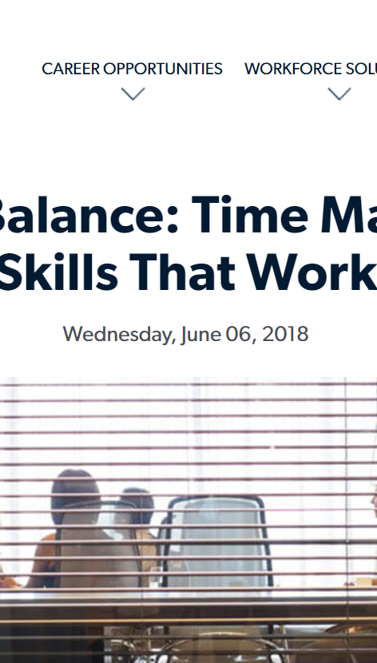
Activity: Time Management Skills That Work
Here are some time-tested tips for managing your time.
Click HERE to read and begin implementing some steps today

Slide 25
Stress Management and Self-Care Practices
Stress management and self-care practices are also vital for maintaining work-life balance and overall wellbeing.
Regular exercise, a balanced diet, adequate sleep, mindfulness practices, and recreational activities can help manage stress levels.
For women, who according to EU-OSHA reports often experience work-related stress more frequently, these practices can be particularly crucial.

Slide 26

Leveraging Company Policies and Resources
Companies often have policies in place that can assist employees in achieving work-life balance. These may include flexible working hours, telecommuting, and family leave policies. It's important to be aware of and make use of these policies.
The EU's New Strategic Framework on Health and Safety at Work 2014-2020 encourages organizations to promote such policies for the well-being of their employees.
In this article it presents 4 Tips for Identifying an Employer’s Work-Life Balance

Slide 27
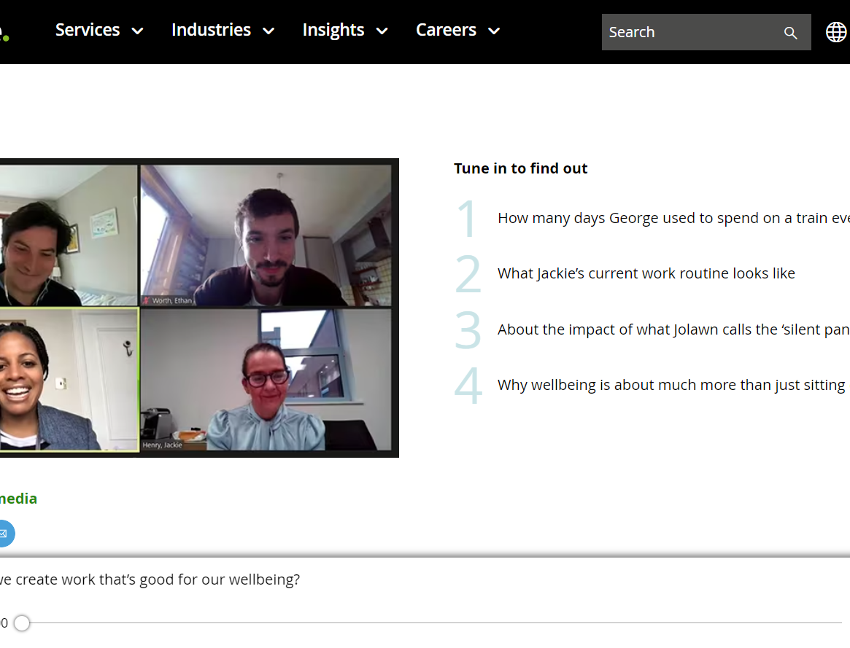
PODCAST: Deloitte: How do we create work that’s good for our wellbeing?
We have so many questions. What’s working life like right now for people? What are the small things that are working well? What are others struggling with?
Looking forward, how do we make hybrid working work? Can we create work that’s actually good for our wellbeing? What are the big things employers need to think about? Could we really have the best of both worlds?
Listen HERE!

Slide 28
Activities: Personal Project: Crafting a Personal Work-Life Balance Plan
Objective: To enable participants to develop their own personal plan for achieving a better work-life balance.
Instructions:
Ask each participant to reflect on their current work-life balance, the boundaries they have in place, their time management skills, and their stress management techniques.
Have participants draft a personal work-life balance plan that includes strategies for setting boundaries, managing their time more effectively, and managing stress.
Encourage participants, particularly women, to consider any unique challenges they face and how they might address these in their plans, drawing on the strategies discussed in this unit.

Slide 29
Activities: Role Play: Implementing Boundaries and Time Management Techniques
Objective: To provide participants with a practical understanding of how to implement boundaries and time management techniques.
Instructions:
Divide participants into pairs or small groups and assign each a scenario that requires setting boundaries or implementing time management techniques at work.
Ask each group to role play their scenario, demonstrating both an ineffective and an effective way of handling the situation.
Facilitate a group discussion on each scenario, drawing parallels to strategies outlined in the EU's health and safety at work frameworks.

Slide 30
References for Unit 3
16 Ways To Achieve Work-Life Balance By Setting Better Boundaries https://www.forbes.com/sites/forbescoachescouncil/2021/02/01/16-ways-to-achieve-work-life-balance-by-setting-better-boundaries/
How to set healthy boundaries as a working parent that really work: https://www.worklifemother.com/post/how-to-set-healthy-boundaries-as-a-working-parent-that-really-work
Implementing the work-life balance directive in times of COVID-19: new prospects for post-pandemic workplaces in the European Union? Sabrina D’Andreacorresponding: https://www.ncbi.nlm.nih.gov/pmc/articles/PMC8892814/
The European Pillar of Social Rights Action Plan: https://op.europa.eu/webpub/empl/european-pillar-of-social-rights/en/
‘Right to disconnect’ should be an EU-wide fundamental right, MEPs say: https://www.europarl.europa.eu/news/en/press-room/20210114IPR95618/right-to-disconnect-should-be-an-eu-wide-fundamental-right-meps-say
How Time Management Can Help Strike a Work-Life Balance: https://emeritus.org/blog/how-time-management-can-help-strike-a-work-life-balance/
The Effects of Work & Life Imbalance: https://work.chron.com/effects-work-life-imbalance-5967.html
Poor work-life balance leads to poor health later in life: https://www.medicalnewstoday.com/articles/313755#:~:text=Damaging%20effects%20include%20a%20higher,than%20those%20working%20standard%20hours.
Why Work-Life Balance Is Important (With Benefits and Steps): https://ca.indeed.com/career-advice/career-development/why-work-life-balance-is-important

Slide 31

Organisational Responsibilities towards Work-Life Balance
04

Slide 32

Understanding Legal Responsibilities and Ethical Considerations
Organisations have legal responsibilities to ensure a safe and healthy work environment, which includes fostering a positive work-life balance.
The European Framework Directive on Safety and Health at Work (Directive 89/391 EEC) stipulates that employers have a duty to ensure workers' safety and health in all work-related aspects.
Ethical considerations also come into play, as organisations have a moral responsibility to support employees' wellbeing and personal needs, which includes respecting their time outside of work.

Slide 33

Establishing Policies that Promote Work-Life Balance
Establishing policies that promote work-life balance can significantly impact an organisation's culture and its employees' wellbeing.
Such policies might include flexible working hours, remote work options, family leave policies, and guidelines to prevent after-hours work-related communications.
According to the European Pillar of Social Rights, promoting work-life balance is essential for supporting gender equality and fostering inclusive growth, urging organisations to consider these policies.

Slide 34

Promoting Wellness and Mental Health in the Workplace
Workplaces play a pivotal role in promoting wellness and mental health.
This can involve implementing wellness programs, offering mental health resources, providing training on stress management, and creating an open dialogue about mental health.
The European Framework for Psychosocial Risk Management (PRIMA-EF) highlights the importance of proactive psychosocial risk management and promoting wellness in the workplace to foster a healthy work environment.

Slide 35

Flexible Working Hours, Childcare Support, and Beyond
Organizations can adopt numerous strategies to support women. These include options for flexible working hours, work-from-home alternatives, on-site childcare, and employee assistance programs.
For instance, Vodafone's 2015 global maternity policy offers 16 weeks of fully paid maternity leave and reduced work hours on full pay for the first six months post-return.

Slide 36
Activity - Group Exercise: Designing a Work-Life Balance Policy
Objective: To give participants a practical understanding of creating policies that promote work-life balance.
Instructions:
Divide participants into small groups.
Assign each group the task of designing a work-life balance policy for a hypothetical organisation, considering factors such as flexible working hours, remote work, and family leave.
Have each group present their policy to the class, explaining their rationale behind each element of the policy.
Facilitate a class-wide discussion comparing these policies to the recommendations within the European Pillar of Social Rights and the EU's New Strategic Framework on Health and Safety at Work.

Slide 37
Case Study: Organisational Response to Mental Health Concerns
Objective: To provide participants with an understanding of how organisations can address mental health concerns effectively.
Instructions:
Provide each participant with a case study detailing an organisation's response to emerging mental health concerns within their workforce.
Ask participants to analyse the case study, focusing on the actions taken by the organisation, their effectiveness, and any areas for improvement.
Facilitate a class-wide discussion on the case study, encouraging participants to reflect on how similar strategies might be implemented in their own workplaces following guidelines such as those provided in the PRIMA-EF

Slide 38
References for Unit 4
Who is responsible for protecting work-life balance? It depends who you ask https://www.fastcompany.com/90720956/who-is-responsible-for-protecting-work-life-balance-it-depends-who-you-ask
Is It An Employer’s Responsibility To Ensure Employees Have A Good Work Life Balance? https://joneschase.com/2021/06/employers-responsibility-for-work-life-balance/
Directive 89/391/EEC - OSH "Framework Directive“ https://osha.europa.eu/en/legislation/directives/the-osh-framework-directive/1
Why Work-Life Balance Is Important (With Benefits and Steps) https://ca.indeed.com/career-advice/career-development/why-work-life-balance-is-important
European Framework for Psychosocial Risk Management (PRIMA-EF) https://apps.who.int/iris/bitstream/handle/10665/43966/9789241597104_eng_Part1.pdf;jsessionid=09B83CC5F04B42FD38AFE3B6FB26C5F3?sequence=1
Vodafone offers 16 weeks paid parental leave to all employees https://www.vodafone.com/news/inclusion/vodafone-supports-families-with-new-global-policy-offering-16-weeks-paid-parental-leave-to-all-employees

Slide 39

Managing Remote Teams and Ensuring Effective Communication
05

Slide 40

Importance of Remote Teams in Today’s Work Environment
In the wake of technological advancements and changing work patterns, remote teams have become a significant aspect of today's work environment.
They enable businesses to source talent from a wider pool and offer employees greater flexibility and autonomy.
However, managing remote teams requires a distinct set of skills and strategies, particularly concerning communication and maintaining work-life balance.
The European Pillar of Social Rights emphasizes the importance of adapting to changing work environments and promoting work-life balance, even in remote work contexts.

Slide 41
Building and Leading a Remote Team: Key Principles and Strategies
Key principles for building and leading a remote team include clear communication, trust-building, fostering a sense of community, and setting clear expectations.
Remote leaders should be skilled in digital tools, show empathy, and be adaptable to various situations.
Strategies may include regular check-ins, promoting collaboration, and acknowledging accomplishments.
The EU’s OSHA Framework highlights the importance of adapting leadership styles to changing work structures, including remote teams.

Slide 42
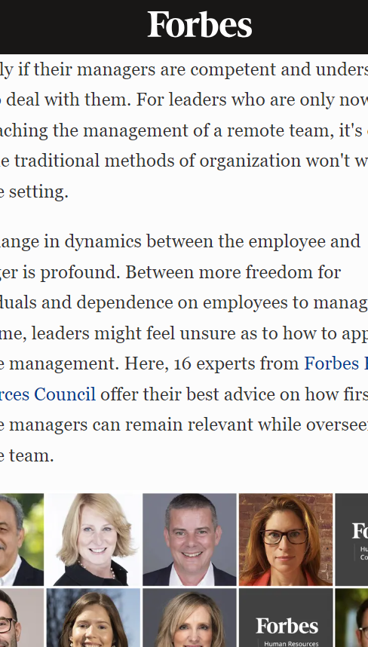
Activity: 16 Tips For Leaders Managing Their First Remote Team
Here, 16 experts from Forbes Human Resources Council offer their best advice on how first-time remote managers can remain relevant while overseeing a remote team.

Slide 43

Communication within Remote Teams: Tools, Techniques and Best Practices
Effective communication within remote teams can be facilitated through a variety of digital tools, including email, video conferencing, instant messaging, and project management software.
When you work in the same location, it's much easier to pick up on a variety of cues (body language, facial expressions, etc), but the benefits of being remote outweigh many of the downsides.
Fortunately, over the past few years, there's been an increase in the number of tools for remote teams for the ever-increasing number of remote-first or fully remote companies. These work apps help your remote team be as productive as possible and improve remote team collaboration, even if you're remote a few days a week. Click HERE to review the “25 Best Remote Work Software for Teams (2023 Edition)”

Slide 44
Overcoming Challenges and Common Pitfalls of Remote Team Management
Challenges of remote team management include communication issues, feelings of isolation among team members, and difficulty in monitoring performance. To overcome these, organisations can implement clear communication protocols, create opportunities for social interaction, and focus on outcomes rather than activity.
EU's New Strategic Framework on Health and Safety at Work emphasizes the importance of addressing such challenges to ensure the mental well-being of remote workers.

Slide 45
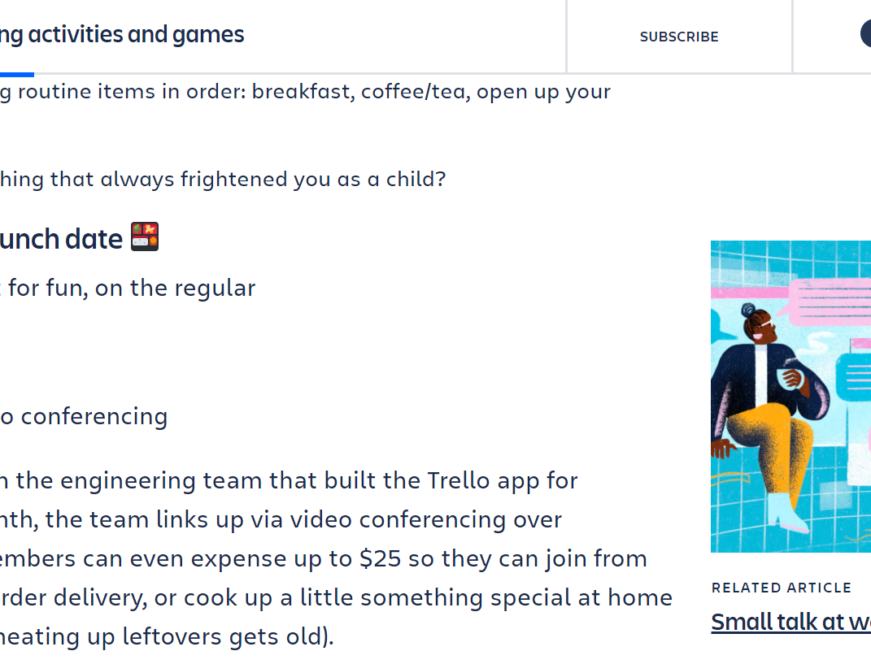
ACTIVITY: Fun remote team building activities for any occasion
Choose what’s right for your team based on these categories:
Real-time vs. asynchronous – Do you need to do this simultaneously, or can each person participate at whatever time works best for them?
Practical vs. just for fun – Is the activity intentionally unproductive (which is not necessarily a bad thing), or does it serve the dual purpose of building social bonds and improving the way you work in a more tangible way?
Click HERE to try out one of the 18 ideas for virtual team games and activities

Slide 46
Activities: Group Discussion: Sharing Personal Experiences and Challenges of Remote Work
Objective: To facilitate sharing and learning from personal experiences related to remote work.
Instructions:
Divide participants into small groups.
Ask each group to share their experiences and challenges encountered in remote work, and to discuss potential solutions.
Facilitate a class-wide discussion on these experiences, relating them to the content of this unit and EU's strategies and frameworks

Slide 47
Case Study: Successful Remote Teams and their Strategies
Objective: To provide participants with real-life examples of successful remote teams.
Instructions:
Provide each participant with a case study of a successful remote team. (e.g. Consider Telefónica Germany, recipient of the 2020 German Award for Work-Life Balance. )
Ask participants to analyse the strategies and practices used by these teams.
Facilitate a class-wide discussion on the case study, encouraging participants to consider how similar strategies might be applied in their own context

Slide 48
Practical Task: Using a Remote Communication Tool
Objective: To familiarise participants with using a remote communication tool effectively.
Instructions:
Select a popular remote communication tool (like Slack, Microsoft Teams, or Zoom).
Ask participants to complete a task using this tool, such as sending a message, setting up a meeting, or sharing a document.
Facilitate a discussion on the experience, including any challenges faced and how these can be mitigated in a real-world

Slide 49
References for Unit 4
8 reasons why remote work is still important
https://www.happeo.com/blog/8-reasons-why-your-company-needs-remote-work#:~:text=Remote%20work%20improves%20work%2Dlife,their%20personal%20and%20professional%20lives.
11 Methods of Effective Remote Team Communication
https://www.indeed.com/career-advice/career-development/remote-team-communication

Slide 50

05
Self assessment

Slide 51
SELF- ASSESSMENT 1/4
QUESTION 1: What is the definition of work-life balance?
a) Prioritizing professional activities over personal interests.
b) The harmonious distribution of time, energy, and attention between professional activities and other essential aspects of life.
c) Ignoring personal interests for the sake of professional obligations.
d) Working tirelessly to increase productivity and morale in professional environments.
QUESTION 2 : According to the European Agency for Safety and Health at Work (EU-OSHA), why is achieving a satisfactory work-life balance important?
a) It enhances individuals' wellbeing and satisfaction, and impacts productivity and morale in professional environments.
b) It increases the number of hours worked, leading to higher productivity.
c) It diminishes the importance of personal and social interactions.
d) It encourages workers to put more effort into their professional activities at the expense of their personal lives.

Slide 52
SELF- ASSESSMENT 2/4
QUESTION 3: How does a balanced approach to work and personal life benefit individuals?
a) It increases the likelihood of job burnout due to overwork.
b) It diminishes their effectiveness at work due to divided attention.
c) It allows individuals to meet their professional obligations without jeopardising their health and personal lives, thereby enhancing personal satisfaction and professional effectiveness.
d) It encourages neglect of personal interests for the sake of work.
QUESTION 4 : Preserving a healthy work-life balance contributes to improved health, alleviates stress levels, enhances job satisfaction, and reduces employee absenteeism. According to the EU Strategy on Health and Safety at Work 2021-2027, facilitating work-life balance is a fundamental aspect of improving occupational safety and health.
True
False

Slide 53
SELF- ASSESSMENT 3/4
QUESTION 5: How does corporate culture impact work-life balance within an organisation
a) It does not play any role in shaping the work-life balance of employees.
b) A culture that encourages long working hours and values employees based on their time spent in the office can facilitate a healthy work-life balance.
c) A culture that promotes flexibility, values employee wellbeing, and respects personal time can contribute to a poor work-life balance.
d) A culture that promotes flexibility, values employee wellbeing, and respects personal time can facilitate a healthy work-life balance.
QUESTION 6:What role does childcare support play in improving work-life balance?
a) Providing childcare support has no significant impact on work-life balance.
b) Childcare support involves providing direct access to childcare facilities, providing subsidies, or offering flexible schedules that accommodate childcare needs, thus alleviating stress and improving work-life balance.
c) Childcare support leads to higher stress levels and disrupts work-life balance.
d) Childcare support decreases gender equality in the workforce.

Slide 54
SELF- ASSESSMENT 4/4
QUESTION 7: What is the significance of remote teams in today's work environment, and what challenges do they present?
a) Remote teams limit the talent pool and reduce employee flexibility and autonomy.
b) Remote teams enable businesses to source talent from a wider pool and offer employees greater flexibility and autonomy, but require unique skills and strategies for managing communication and work-life balance.
c) Remote teams have no significant impact on the work environment.
d) Managing remote teams does not require any distinct set of skills and strategies.
QUESTION 8:What are some key principles and strategies for building and leading a remote team?
a) Avoiding communication, building mistrust, isolating team members, and setting vague expectations.
b) Clear communication, trust-building, fostering a sense of community, setting clear expectations, regular check-ins, promoting collaboration, and acknowledging accomplishments.
c) Disregarding digital tools, showing apathy, and being rigid in various situations.
d) Discouraging collaboration and ignoring accomplishments.

Slide 55
Go to Module 2:
Understanding Responsibilities and Laws: Organisational, Supervisory, and Individual Perspectives

